Slide 1
Healthcare Predictive Analysis
Machine Learning Model for Heart Disease Prediction

Slide 2
Problem Statement
Heart disease is a leading cause of mortality worldwide. Early detection and accurate prediction of heart disease can significantly improve patient outcomes by enabling timely intervention and preventive measures. The objective of this project is to develop a machine learning model that can effectively predict the presence or absence of heart disease based on various medical and lifestyle factors.

Slide 3
Research Objective
The goal of this project is to build a predictive model that can accurately classify individuals as either having or not having heart disease. By analysing a comprehensive set of patient attributes, including demographic, clinical, and lifestyle factors, the model aims to identify patterns and features indicative of the presence or absence of heart disease.

Slide 4
Data Information
• The dataset provided for this project is a subset of data our team worked on for a project of Parkway Pantai to understand the influence of various factors on the heart disease.
• The data provided to you contains all the required detail to understand the impact on heart such as cholesterol level, blood pressure, alcohol consumption etc.
• All the information about the features is present in Data_Dictionary.pdf

Slide 5
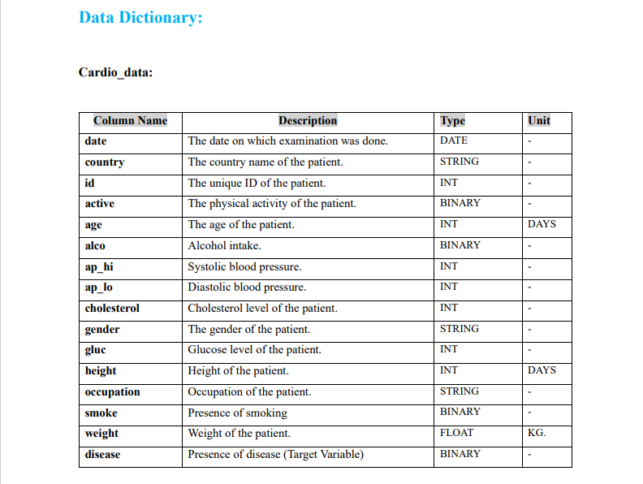

Slide 6
Data Cleaning & Preprocessing
Importing Necessary Libraries
We have imported the numpy and pandas libraries in the above lines of code, respectively. Then, we imported the matplotlib library. This is useful for interactive visualizations in Python. Seaborn is another data visualization library more suited for handling pandas dataframe. The next step would be to create a dataframe. Pandas dataframe is a 2-dimensional tabular structure with rows and columns.And then loading the data set to start data cleaning and preprocessing.

Slide 7
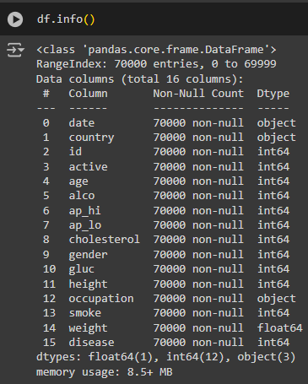
Next, we need to find the information in the dataset. This can be done by using the info() function. The information would comprise range index, data columns, non-null count, memory usage, and datatypes. The following are the line of code and the output.

Slide 8
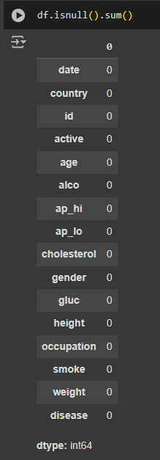
Next, we check for null values in the pandas dataframe with the help of the isnull() function. The function isnull().sum() displays the missing values in the dataset. The line of code and the output are
From the output, it can be seen that there are no missing values in the dataset.

Slide 9
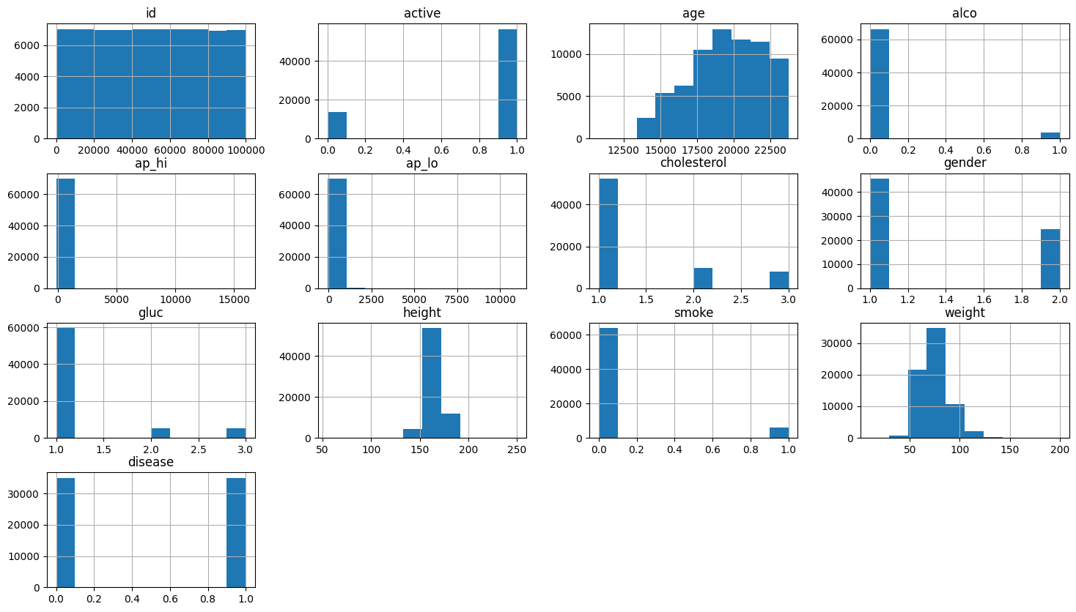
Distribution Analysis
The histograms provide a visual representation of the distribution of each feature in the dataset, offering valuable insights into the data's characteristics.
Key Observations:
Normal Distribution: Several features exhibit a roughly normal distribution, indicating a central tendency with data points clustered around the mean. These features include age, cholesterol, gender, height, and weight.
Skewed Distribution: Certain features display a skewed distribution, where the majority of data points are concentrated towards one end of the range. This is evident in active, alco, ap_hi, ap_lo, gluc, and smoke.
Class Imbalance: The disease feature shows a clear class imbalance, with a significantly higher number of individuals without heart disease compared to those with the condition.

Slide 10
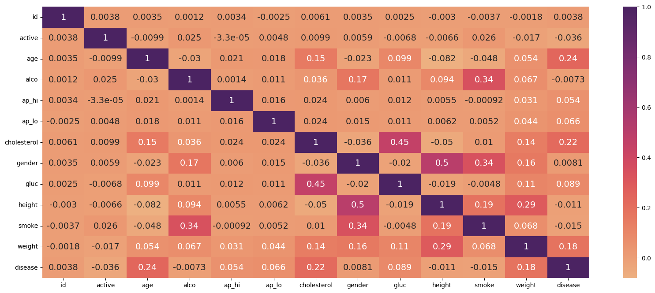
The image you provided is a correlation heatmap. It displays the correlation between different features in a dataset. Here's how to interpret it:
Correlation:
Positive Correlation: Values closer to 1 indicate a strong positive correlation. This means that as one variable increases, the other also tends to increase.
Negative Correlation: Values closer to -1 indicate a strong negative correlation. This means that as one variable increases, the other tends to decrease.
No Correlation: Values close to 0 indicate no correlation or a very weak correlation between the variables.
Interpretation of the Heatmap:
Strong Positive Correlations:
age and cholesterol have a strong positive correlation (0.24). This suggests that as age increases, cholesterol levels tend to increase as well.
alco and smoke have a strong positive correlation (0.34). This indicates that individuals who consume alcohol are more likely to smoke.
height and weight have a strong positive correlation (0.29). This is expected, as taller individuals tend to weigh more.
Moderate Positive Correlations:
age and ap_hi (systolic blood pressure) have a moderate positive correlation (0.18). This suggests that as age increases, systolic blood pressure tends to increase.
cholesterol and disease have a moderate positive correlation (0.22). This indicates that higher cholesterol levels are associated with an increased risk of heart disease.
Moderate Negative Correlations:
active and disease have a moderate negative correlation (-0.36). This suggests that being physically active is associated with a lower risk of heart disease.
smoke and active have a moderate negative correlation (-0.34). This suggests that individuals who smoke are less likely to be physically active.
Weak Correlations:
Most of the other correlations are weak, indicating little or no linear relationship between the variables.

Slide 11
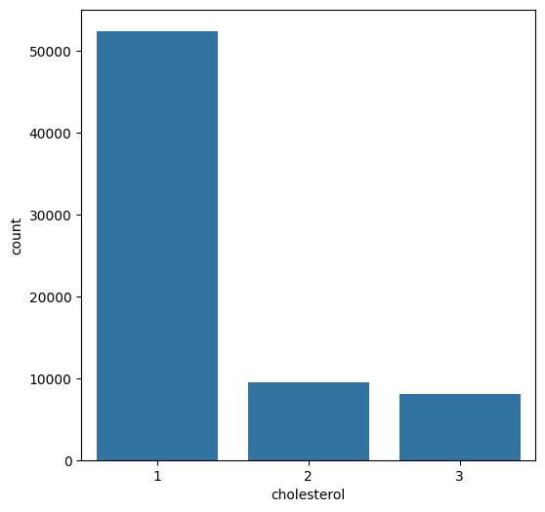
Now, we start with understanding the relationship between the different data features.
The bar chart shows the distribution of cholesterol levels in a dataset. The x-axis represents the different cholesterol levels (1, 2, and 3), and the y-axis represents the count of individuals at each level.
Interpretation:
Most individuals have cholesterol level 1. This is evident from the tallest bar, which corresponds to level 1.
Fewer individuals have cholesterol levels 2 and 3. The bars for levels 2 and 3 are significantly shorter than the bar for level 1, indicating that fewer individuals fall into these categories.

Slide 12
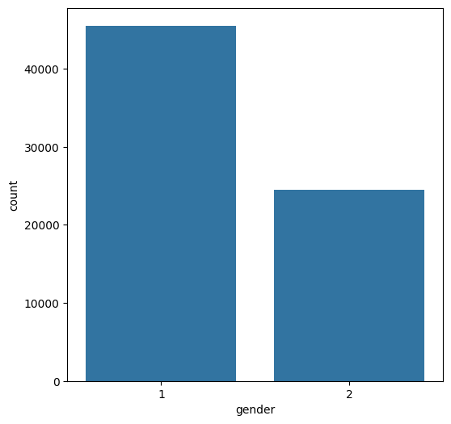
The bar chart shows the distribution of gender in a dataset. The x-axis represents the different genders (1 and 2), and the y-axis represents the count of individuals in each gender category.
Interpretation:
Gender 1 is more prevalent. The bar for gender 1 is taller than the bar for gender 2, indicating that there are more individuals in gender category 1.
Gender 2 is less prevalent. The bar for gender 2 is shorter, suggesting that fewer individuals belong to gender category 2.

Slide 13
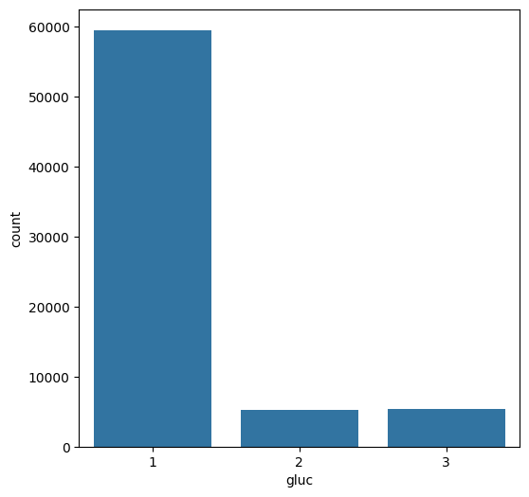
The bar chart shows the distribution of glucose levels in a dataset. The x-axis represents the different glucose levels (1, 2, and 3), and the y-axis represents the count of individuals at each level.
Interpretation:
Most individuals have glucose level 1. This is evident from the tallest bar, which corresponds to level 1.
Fewer individuals have glucose levels 2 and 3. The bars for levels 2 and 3 are significantly shorter than the bar for level 1, indicating that fewer individuals fall into these categories.

Slide 14
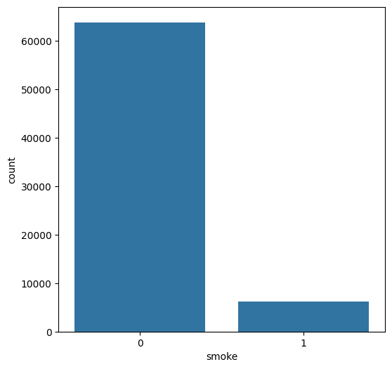
The bar chart shows the distribution of smoking habits in a dataset. The x-axis represents whether an individual smokes (0 for non-smokers, 1 for smokers), and the y-axis represents the count of individuals in each category.
Interpretation:
Most individuals do not smoke. The bar for non-smokers (0) is significantly taller than the bar for smokers (1), indicating that a majority of individuals in the dataset do not smoke.
A smaller proportion of individuals smoke. The bar for smokers is shorter, suggesting that a smaller percentage of individuals in the dataset smoke.

Slide 15
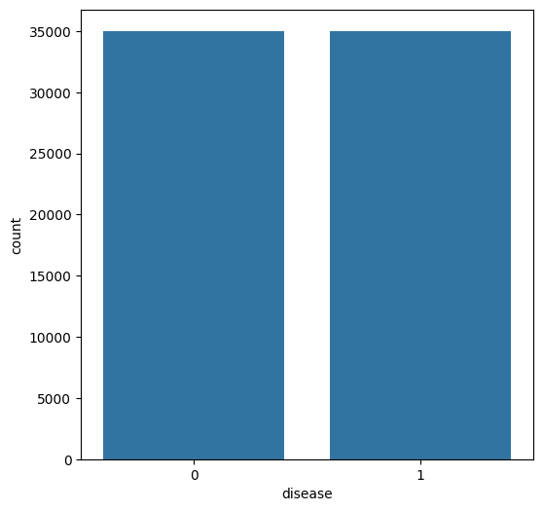
The bar chart shows the distribution of heart disease in a dataset. The x-axis represents whether an individual has heart disease (0 for no disease, 1 for disease), and the y-axis represents the count of individuals in each category.
Interpretation:
The bars for both categories are of similar height. This indicates that there are approximately equal numbers of individuals with and without heart disease in the dataset.

Slide 16
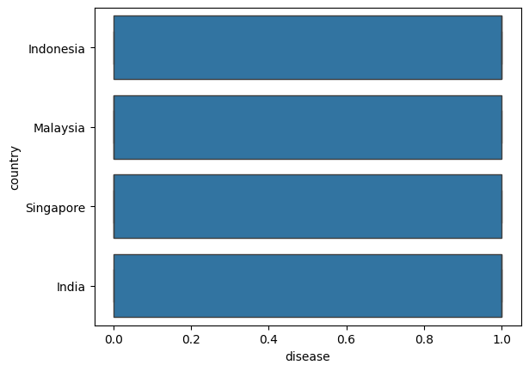
Exploratory Data Analysis (EDA)
The bar chart shows the distribution of heart disease across four countries: Indonesia, Malaysia, Singapore, and India. The y-axis represents the country, and the x-axis represents the prevalence of heart disease.
Interpretation:
All four countries have a similar prevalence of heart disease. The bars for each country are almost the same height, suggesting that the percentage of individuals with heart disease is roughly equal across these countries.

Slide 17
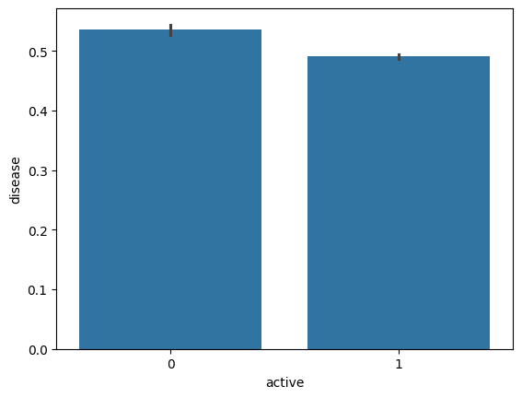
The bar chart shows the relationship between physical activity (active) and the prevalence of heart disease (disease).
Interpretation:
Active individuals have a slightly lower risk of heart disease. The bar for active individuals (1) is slightly shorter than the bar for inactive individuals (0), suggesting that being physically active is associated with a slightly lower risk of heart disease.

Slide 18
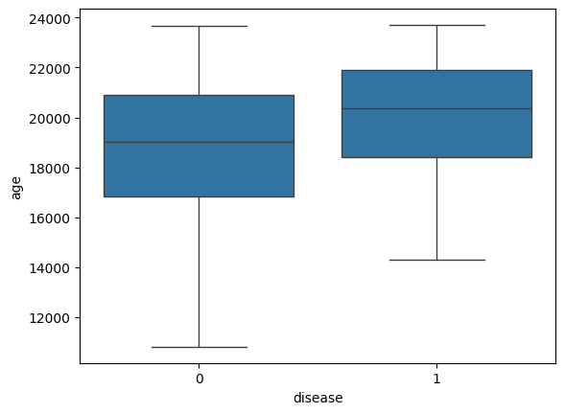
The box plot shows the distribution of age for individuals with and without heart disease.
Interpretation:
Individuals with heart disease tend to be older. The box for individuals with heart disease (1) is shifted to the right compared to the box for individuals without heart disease (0). This indicates that the median age of individuals with heart disease is higher than the median age of individuals without heart disease.
The age distribution is wider for individuals with heart disease. The box and whiskers for individuals with heart disease are longer than those for individuals without heart disease. This suggests that there is more variability in the age of individuals with heart disease, with some individuals being much older than others.

Slide 19
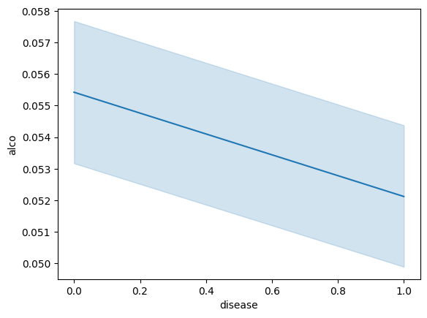
The plot shows the relationship between alcohol consumption (alco) and the presence of heart disease (disease).
Interpretation:
There appears to be a slight negative correlation between alcohol consumption and heart disease. As the prevalence of heart disease increases, the average alcohol consumption decreases.
However, the relationship is weak. The confidence interval around the line is wide, indicating that the observed trend might be due to chance.
Therefore, based on this plot alone, we cannot definitively conclude that alcohol consumption is a significant factor in predicting heart disease.

Slide 20
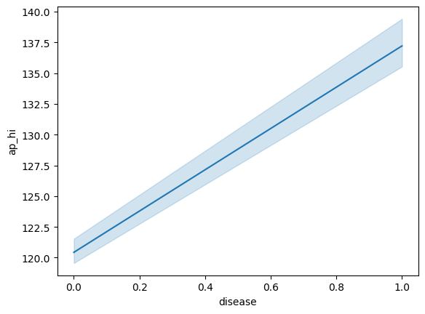
The plot shows the relationship between systolic blood pressure (ap_hi) and the presence of heart disease (disease).
Interpretation:
There appears to be a positive correlation between systolic blood pressure and heart disease. As the prevalence of heart disease increases, the average systolic blood pressure also increases.
The relationship is moderate. The confidence interval around the line is not very wide, suggesting that the observed trend is likely to be statistically significant.
Therefore, based on this plot, we can conclude that systolic blood pressure is a factor associated with the risk of heart disease. Higher systolic blood pressure is associated with a higher risk of heart disease.

Slide 21
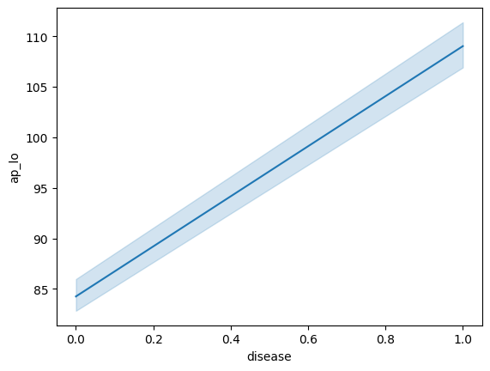
The plot shows the relationship between diastolic blood pressure (ap_lo) and the presence of heart disease (disease).
Interpretation:
There appears to be a positive correlation between diastolic blood pressure and heart disease. As the prevalence of heart disease increases, the average diastolic blood pressure also increases.
The relationship is moderate. The confidence interval around the line is not very wide, suggesting that the observed trend is likely to be statistically significant.
Therefore, based on this plot, we can conclude that diastolic blood pressure is a factor associated with the risk of heart disease. Higher diastolic blood pressure is associated with a higher risk of heart disease.

Slide 22
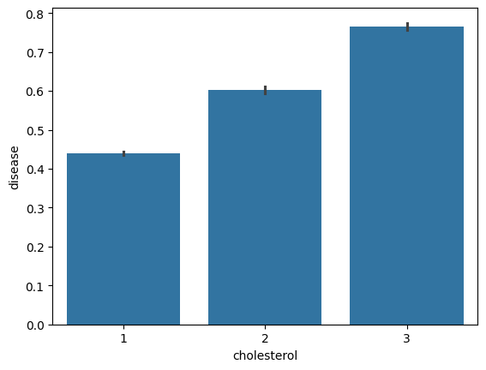
The bar chart shows the relationship between cholesterol levels and the prevalence of heart disease.
Interpretation:
As cholesterol levels increase, the risk of heart disease also increases. The bars for cholesterol levels 2 and 3 are taller than the bar for level 1, indicating that individuals with higher cholesterol levels have a higher risk of heart disease.
The difference in risk between cholesterol levels 1 and 2 is less pronounced than the difference between levels 2 and 3. The increase in risk appears to be more significant as cholesterol levels move from 2 to 3.
Overall, the chart suggests a positive association between cholesterol levels and the risk of heart disease. Individuals with higher cholesterol levels are more likely to develop heart disease.

Slide 23
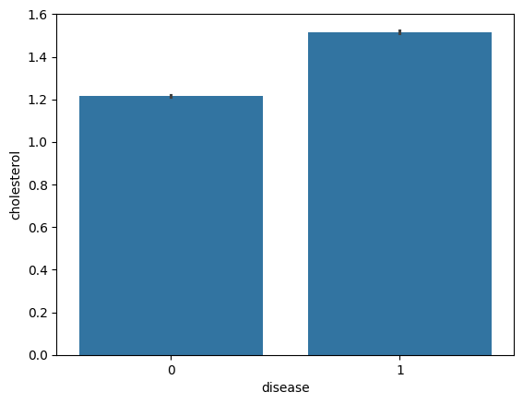
The bar chart shows the relationship between the presence of heart disease and cholesterol levels.
Interpretation:
Individuals with heart disease tend to have higher cholesterol levels. The bar for individuals with heart disease (1) is taller than the bar for individuals without heart disease (0). This indicates that the average cholesterol level is higher among individuals with heart disease.
Therefore, the chart suggests a positive association between cholesterol levels and the risk of heart disease. Higher cholesterol levels are associated with a higher risk of heart disease.

Slide 24
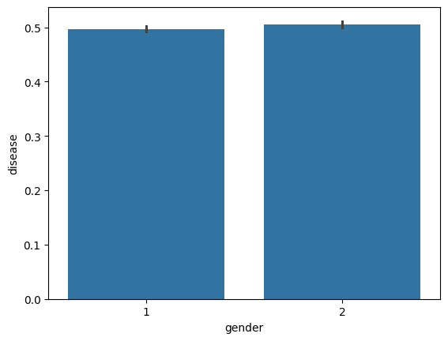
The bar chart shows the relationship between gender and the prevalence of heart disease.
Interpretation:
There appears to be no significant difference in the risk of heart disease between genders. The bars for both genders (1 and 2) are of similar height, suggesting that both genders have a similar risk of developing heart disease.
Therefore, based on this plot, we cannot conclude that gender is a significant factor in predicting heart disease.

Slide 25
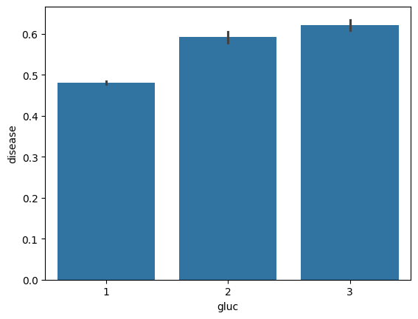
The bar chart shows the relationship between glucose levels and the prevalence of heart disease.
Interpretation:
As glucose levels increase, the risk of heart disease also increases. The bars for glucose levels 2 and 3 are taller than the bar for level 1, indicating that individuals with higher glucose levels have a higher risk of heart disease.
The difference in risk between glucose levels 1 and 2 is less pronounced than the difference between levels 2 and 3. The increase in risk appears to be more significant as glucose levels move from 2 to 3.
Overall, the chart suggests a positive association between glucose levels and the risk of heart disease. Individuals with higher glucose levels are more likely to develop heart disease.

Slide 26
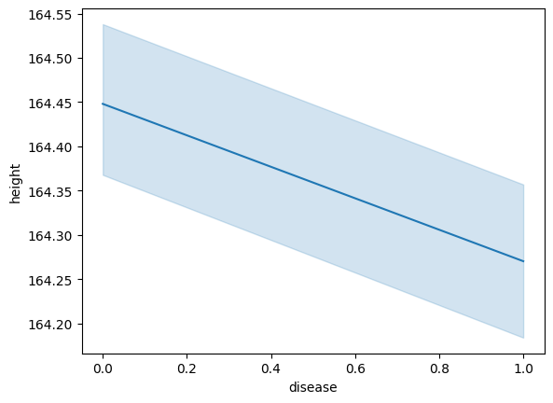
The plot shows the relationship between height and the presence of heart disease.
Interpretation:
There appears to be a very slight negative correlation between height and heart disease. As the prevalence of heart disease increases, the average height decreases.
However, the relationship is extremely weak. The confidence interval around the line is very wide, indicating that the observed trend is likely due to chance.
Therefore, based on this plot, we cannot conclude that height is a significant factor in predicting heart disease.

Slide 27
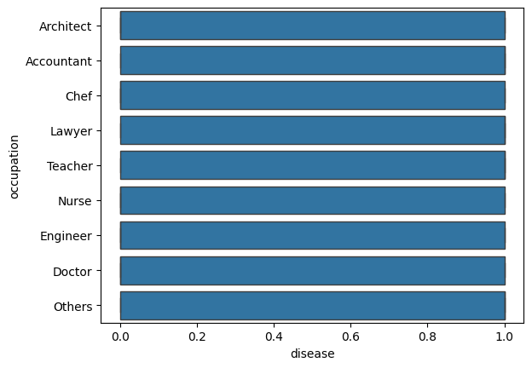
The bar chart shows the relationship between occupation and the prevalence of heart disease.
Interpretation:
There appears to be no significant difference in the risk of heart disease across different occupations. All the bars are of similar height, suggesting that individuals in different occupations have a similar risk of developing heart disease.
Therefore, based on this plot, we cannot conclude that occupation is a significant factor in predicting heart disease.

Slide 28
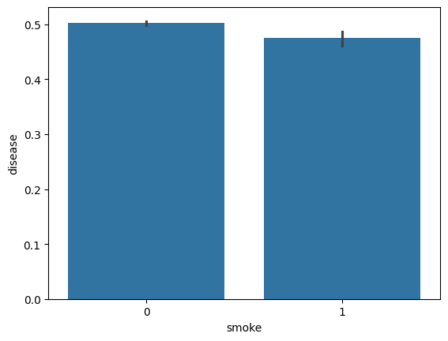
The bar chart shows the relationship between smoking and the prevalence of heart disease.
Interpretation:
Smokers have a slightly higher risk of heart disease compared to non-smokers. The bar for smokers (1) is slightly taller than the bar for non-smokers (0), indicating that smokers have a slightly higher risk of developing heart disease.

Slide 29
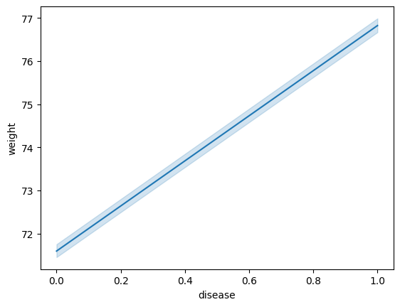
The plot shows the relationship between weight and the presence of heart disease.
Interpretation:
There appears to be a very slight positive correlation between weight and heart disease. As the prevalence of heart disease increases, the average weight also increases.
However, the relationship is extremely weak. The confidence interval around the line is very wide, indicating that the observed trend is likely due to chance.

Slide 30
Model Development
Step 1:- Encoding
Data preparation is required in data science before moving on to modeling. In the data preparation process, we must complete many tasks. One of these critical responsibilities is the encoding of categorical data. We all know that most real-life data contains categorical string values, and most machine-learning models handle only integer values or other understandable formats. All models execute mathematical operations that various tools and methodologies can perform.
Encoding categorical data is turning categorical data into integer format so that data with transformed categorical values may be fed into models to increase prediction accuracy.

Slide 31
Train-Test Split
We split the whole dataset into train set and testset which contains 75% train and 25% test.
We can include this train set into classifiers to train our model and the test set is useful for predicting the performance of the model by different classifiers.

Slide 32
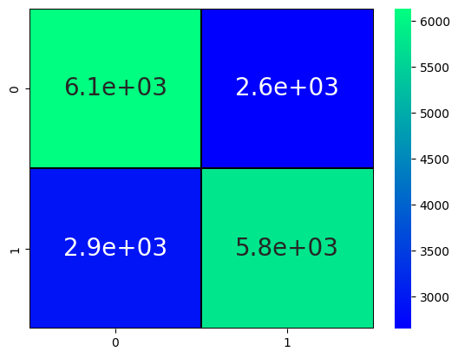
Algorithm Implementation
1 .Logistic Regression
This image is a confusion matrix, a visualization tool used to evaluate the performance of a classification model. Here's how to interpret it:
True Positives (TP): The number of instances correctly predicted as positive. In this case, 6.1e+03 instances were correctly identified as having heart disease.
True Negatives (TN): The number of instances correctly predicted as negative. In this case, 5.8e+03 instances were correctly identified as not having heart disease.
False Positives (FP): The number of instances incorrectly predicted as positive. In this case, 2.6e+03 instances were incorrectly identified as having heart disease.
False Negatives (FN): The number of instances incorrectly predicted as negative. In this case, 2.9e+03 instances were incorrectly identified as not having heart disease.
Overall, the model appears to be performing reasonably well, with a higher number of correct predictions (TP and TN) than incorrect predictions (FP and FN).

Slide 33
Logistic Regression test score
precision recall f1-score support
0 0.68 0.70 0.69 8783
1 0.69 0.66 0.68 8717
accuracy 0.68 17500
macro avg 0.68 0.68 0.68 17500
weighted avg 0.68 0.68 0.68 17500

Slide 34
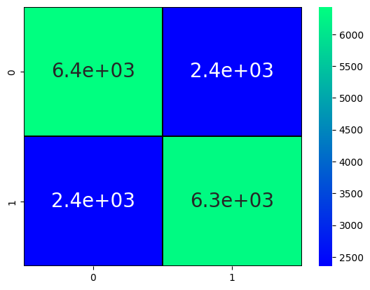
Decision Tree
This image is a confusion matrix, a visualization tool used to evaluate the performance of a classification model. Here's how to interpret it:
True Positives (TP): The number of instances correctly predicted as positive. In this case, 6.4e+03 instances were correctly identified as having heart disease.
True Negatives (TN): The number of instances correctly predicted as negative. In this case, 6.3e+03 instances were correctly identified as not having heart disease.
False Positives (FP): The number of instances incorrectly predicted as positive. In this case, 2.4e+03 instances were incorrectly identified as having heart disease.
False Negatives (FN): The number of instances incorrectly predicted as negative. In this case, 2.4e+03 instances were incorrectly identified as not having heart disease.
Overall, the model appears to be performing reasonably well, with a higher number of correct predictions (TP and TN) than incorrect predictions (FP and FN).

Slide 35
Decision Tree test score
precision recall f1-score support
0 0.73 0.73 0.73 8783
1 0.73 0.73 0.73 8717
accuracy 0.73 17500
macro avg 0.73 0.73 0.73 17500
weighted avg 0.73 0.73 0.73 17500

Slide 36
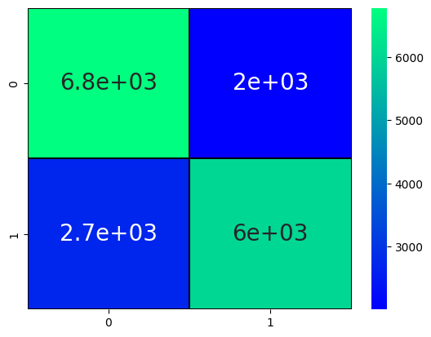
Random Forest Classifier
This image is a confusion matrix, a visualization tool used to evaluate the performance of a classification model. Here's how to interpret it:
True Positives (TP): The number of instances correctly predicted as positive. In this case, 6.8e+03 instances were correctly identified as having heart disease.
True Negatives (TN): The number of instances correctly predicted as negative. In this case, 6e+03 instances were correctly identified as not having heart disease.
False Positives (FP): The number of instances incorrectly predicted as positive. In this case, 2e+03 instances were incorrectly identified as having heart disease.
False Negatives (FN): The number of instances incorrectly predicted as negative. In this case, 2.7e+03 instances were incorrectly identified as not having heart disease.
Overall, the model appears to be performing reasonably well, with a higher number of correct predictions (TP and TN) than incorrect predictions (FP and FN).

Slide 37
precision recall f1-score support
0 0.71 0.77 0.74 8783
1 0.75 0.69 0.72 8717
accuracy 0.73 17500
macro avg 0.73 0.73 0.73 17500
weighted avg 0.73 0.73 0.73 17500

Slide 38
Conclusion
Based on the evaluation of the three models—Logistic Regression, Decision Tree, and Random Forest—on the given dataset, the Random Forest classifier emerged as the best-performing model. Here are the key takeaways from the analysis:
Performance Overview:
The Logistic Regression model demonstrated a reasonable performance with a test accuracy of approximately 69.31%, showing a balance between precision (70.81%) and recall (65.31%). This model is generally reliable for binary classification but may not capture complex patterns as effectively as tree-based methods.
The Decision Tree achieved a perfect training accuracy of 100%, indicating potential overfitting. Its test accuracy was significantly lower at 62.81%, with both precision and recall around 62.62%. This suggests that while it may classify training data accurately, it struggles to generalize to unseen data.
In contrast, the Random Forest classifier also achieved 100% training accuracy, yet it demonstrated a robust test accuracy of 72.81%. With a precision of 72.93% and recall of 70.20%, the Random Forest model strikes a favorable balance, showcasing its ability to effectively identify both classes without sacrificing performance.
Strengths of Random Forest:
The Random Forest model not only provided the highest test accuracy but also maintained a strong balance between precision and recall. Its F1 Score of 72.09% further underscores its effectiveness in handling the classification problem without being overly biased toward either class.
Considerations:
The differences in performance suggest that the Random Forest model is more capable of capturing complex relationships within the data. Its ensemble approach mitigates overfitting, a common issue with individual decision trees, and enhances generalization to new data.
While the Decision Tree may appear appealing with its perfect training score, its inability to maintain performance on the test set highlights the risks of overfitting. In contrast, Logistic Regression, although simpler, may lack the necessary complexity to fully exploit the data's structure.
Recommendation
Given the results, it is recommended to utilize the Random Forest model for predictions in this application due to its superior performance metrics across accuracy, precision, recall, and F1 score. Additionally, further tuning of hyperparameters and feature engineering could potentially enhance the model's performance even more. Overall, Random Forest provides a robust and reliable framework for this classification task, making it the optimal choice among the models tested.

Slide 39
THANK YOU

